Slide 1
Figures for ASC2016

Slide 2
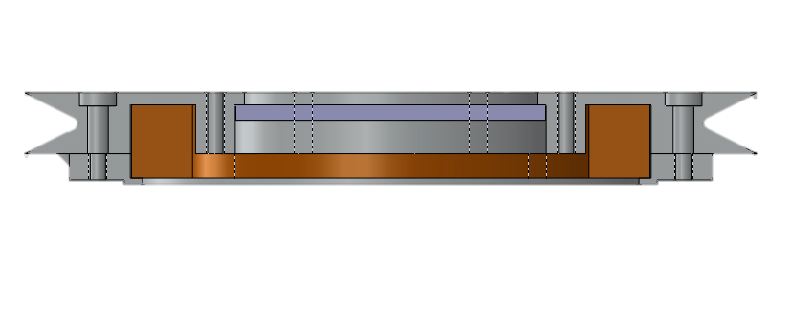
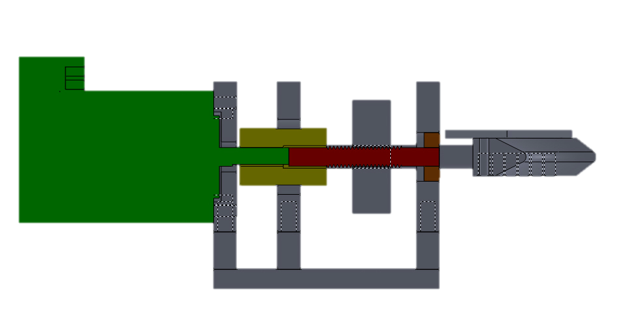
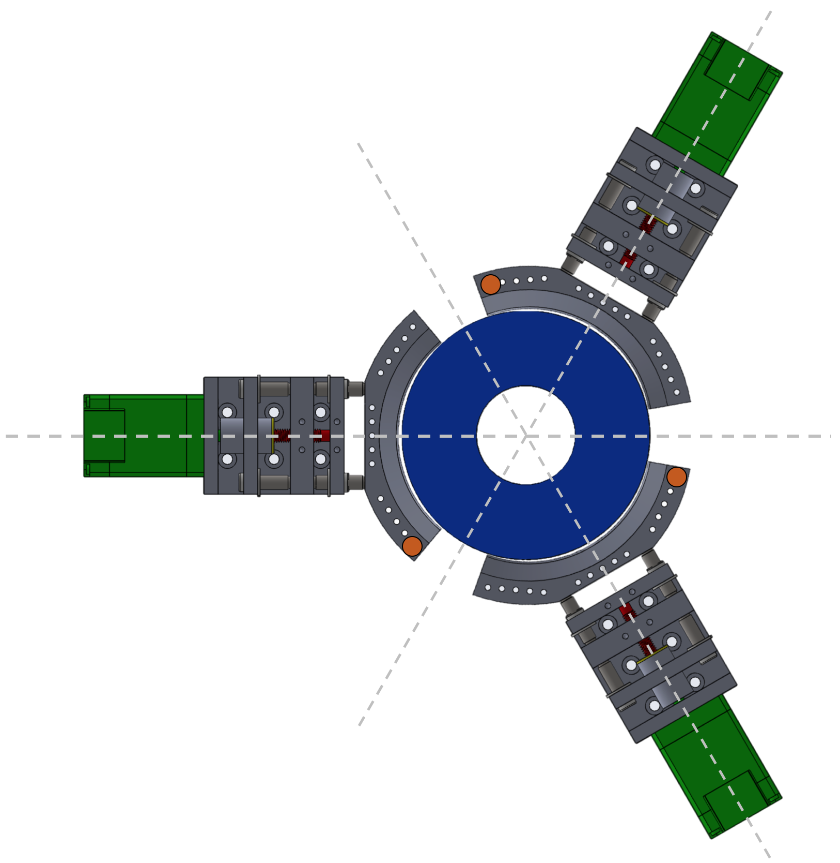
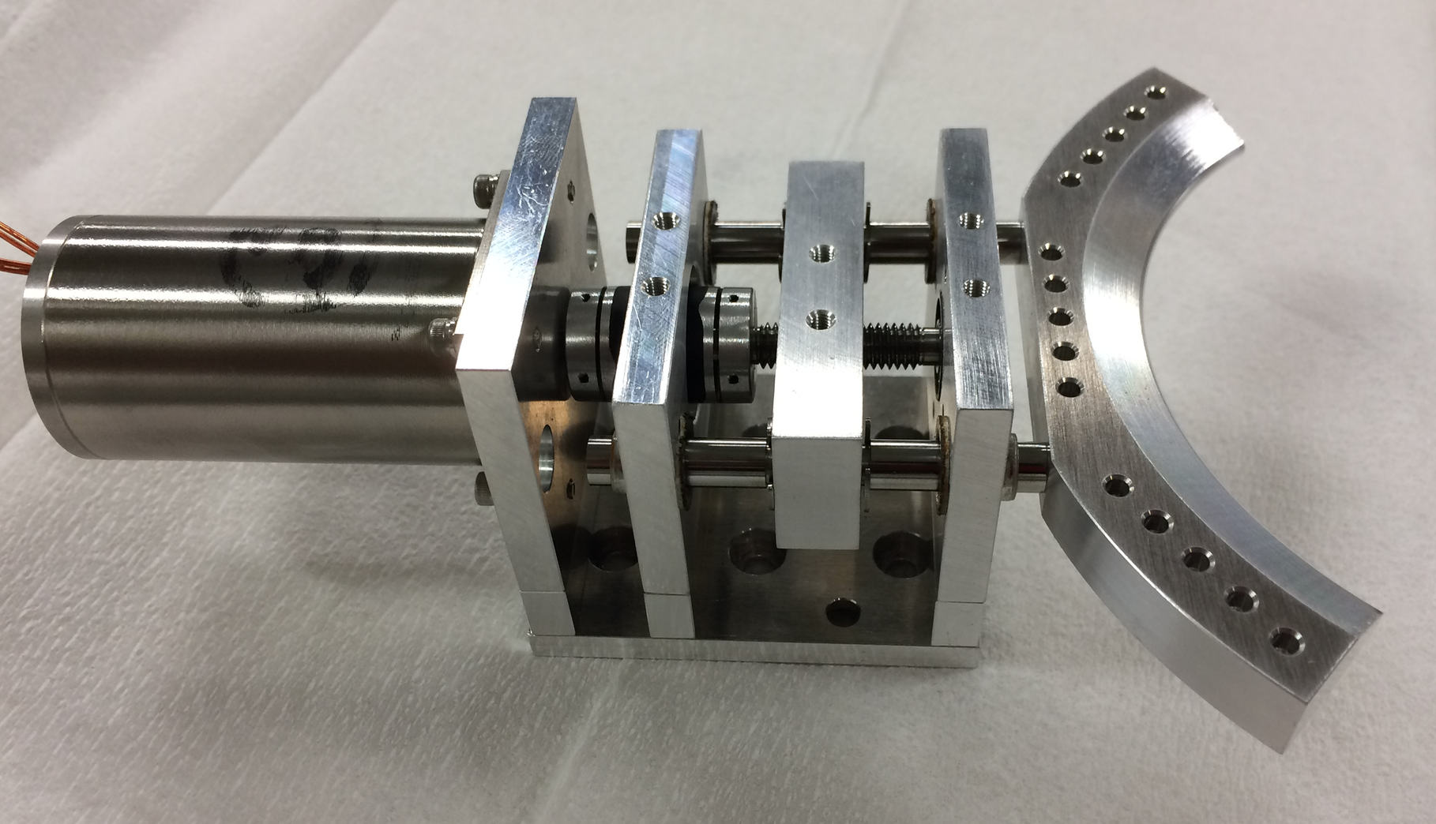
Cross sectional view
Sapphire
Not mounted at the time of this test
Permanent magnet
YBCO
Top view
Gripper2
Arm
Temperature sensor
Gripper1
Cryogenic
stepping
motor
Heater
Three grippers hold the rotor magnet.
Gripper3

Slide 3
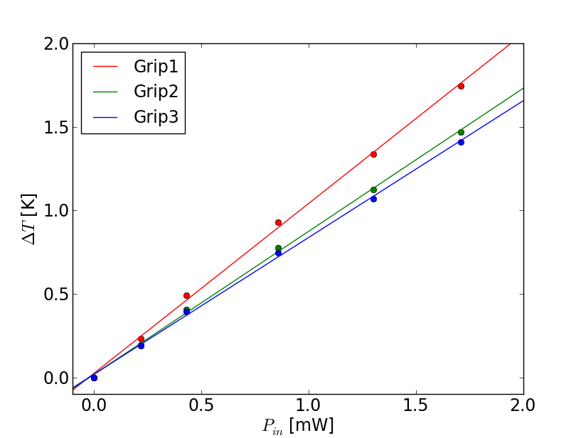

Slide 4
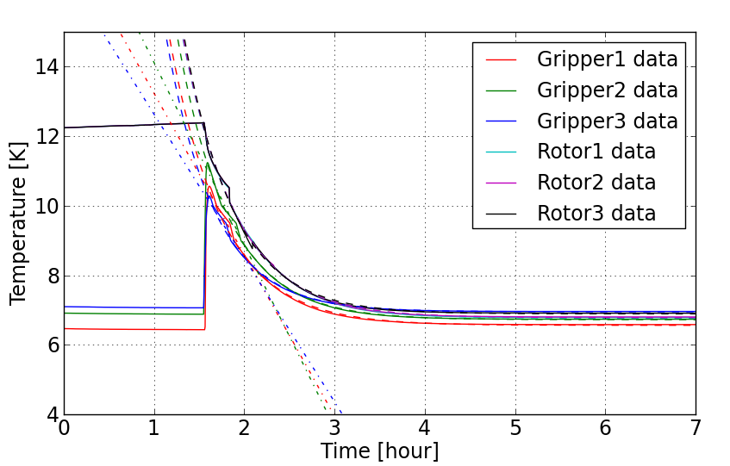
Exponential fit
T_{rotor}
T_{g1,2,3}
Linear fit
The grippers held a rotor.

Slide 5
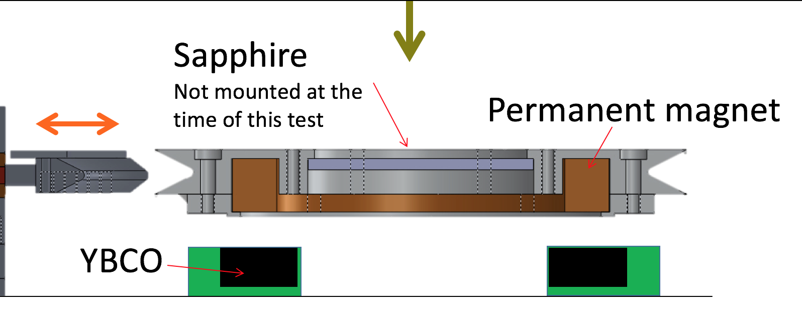
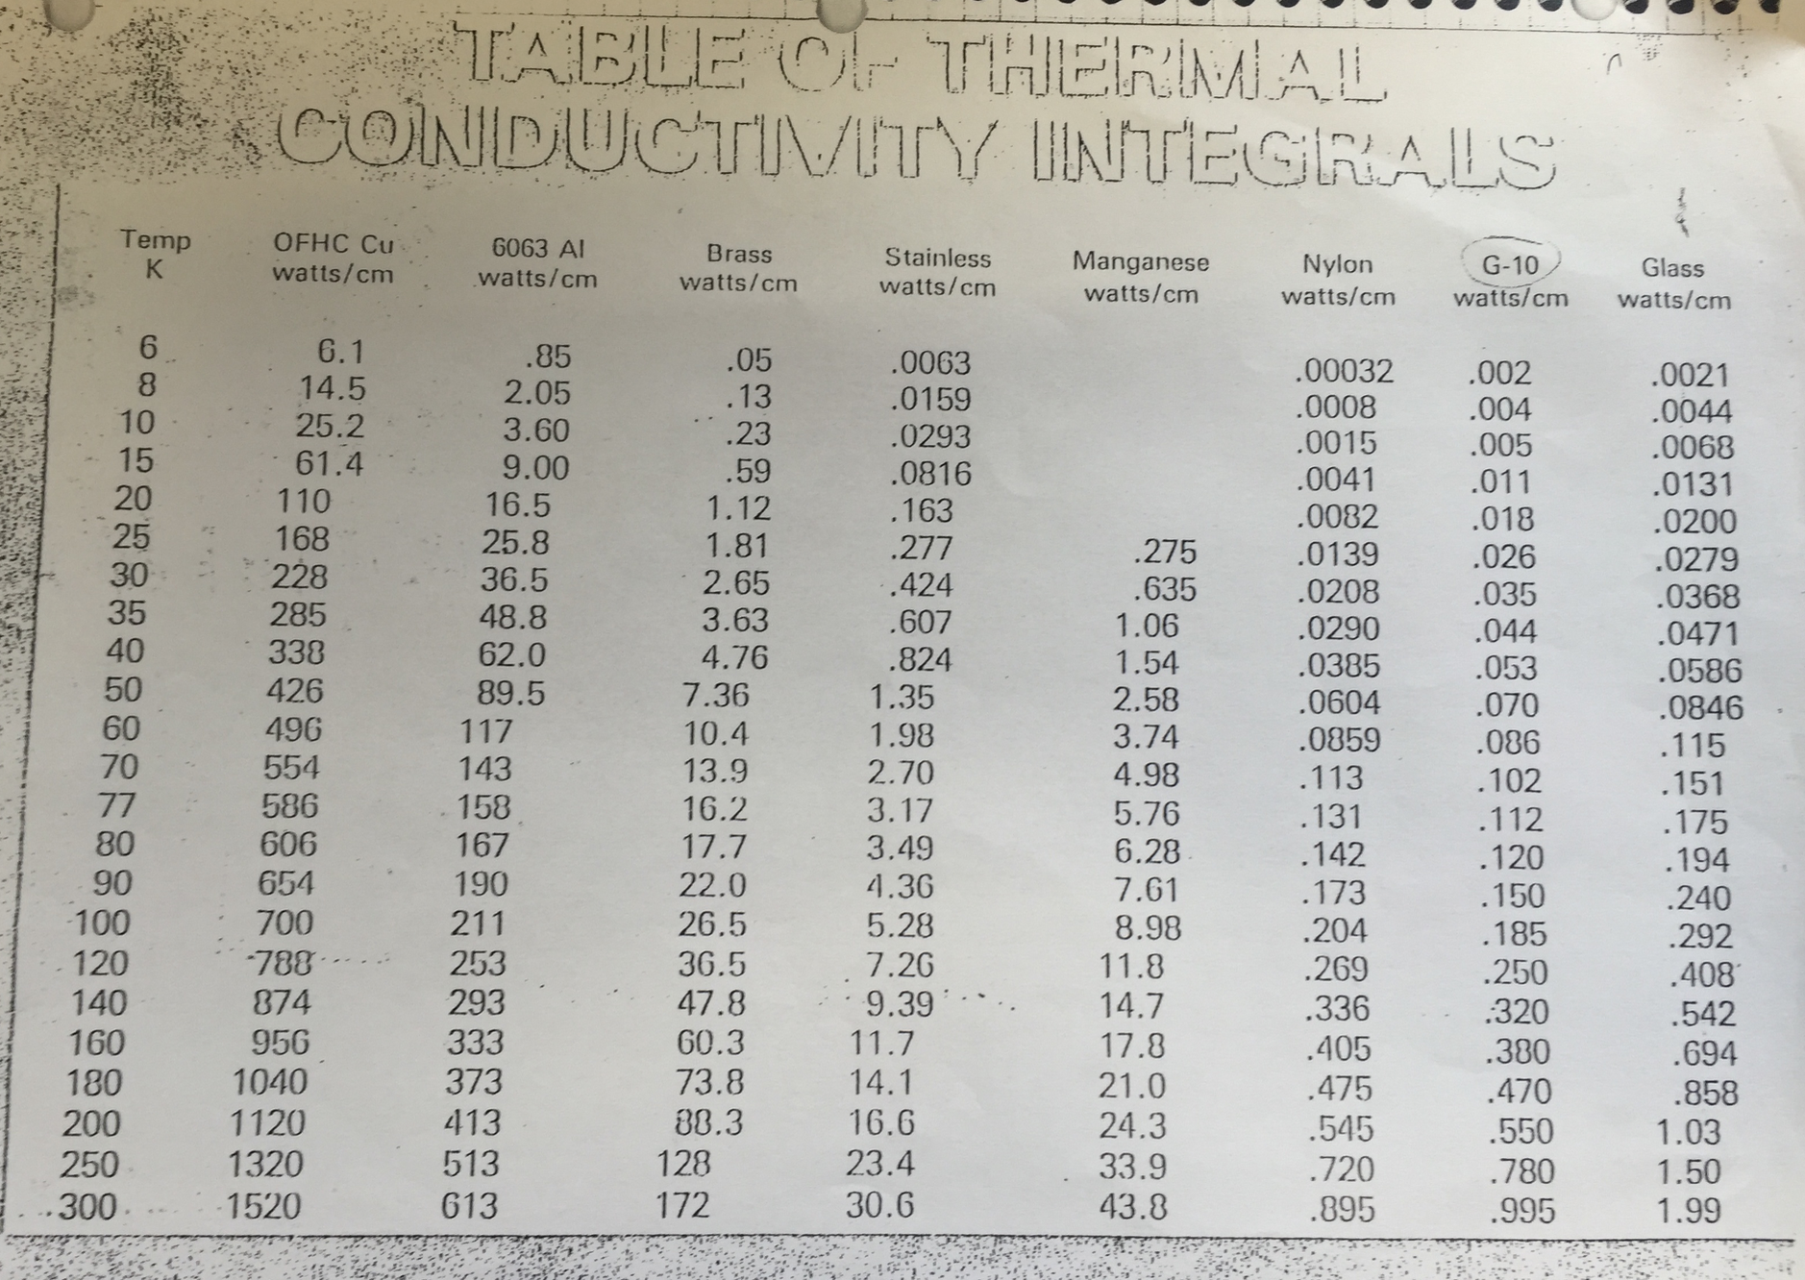
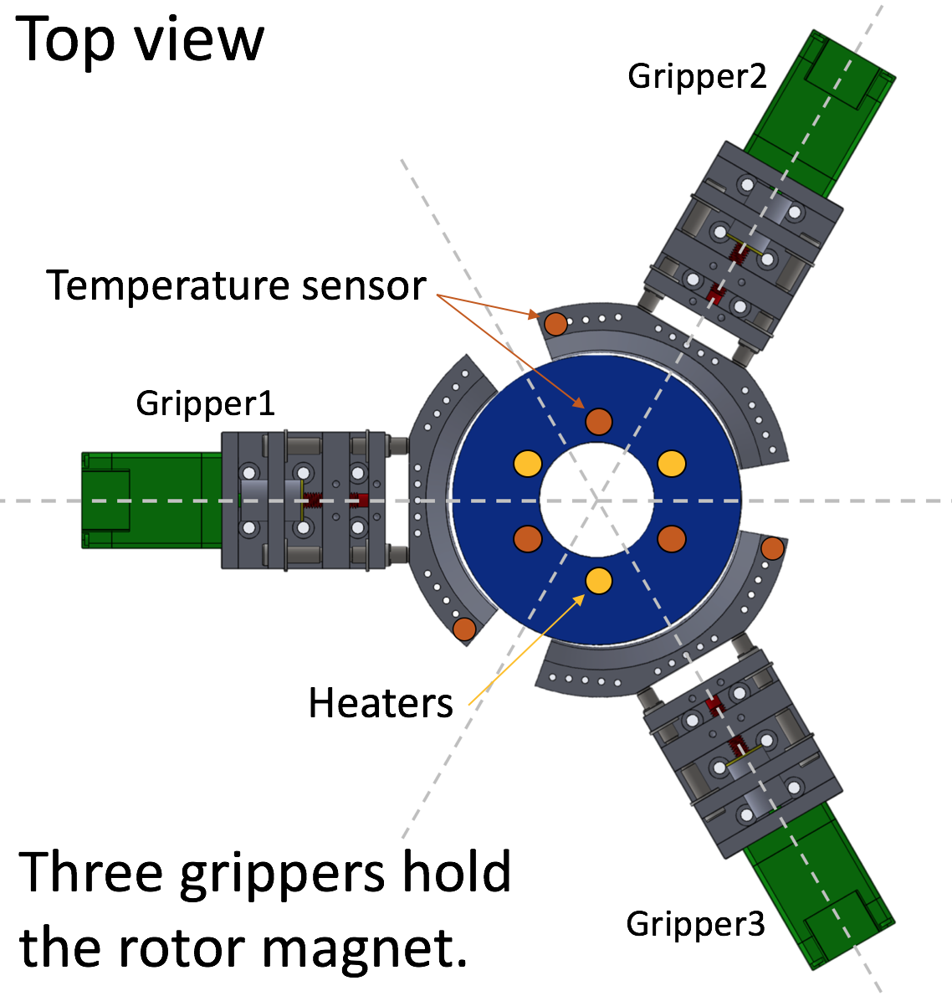
13mm
Distance 65/3 mm
Thickness 13mm
R = 60mm, 100 degs
C = 2pi R x 100/360 = 104.7 mm
A = 104.7mm x 13mm
L = 21.7 mm
A/L = 62.7 mm = 6.27 cm
9-0.85 = 8.15 W/cm (for 15K-6K)
Thus, 8.15 x 6.27 = 51.1 W
51.1W/9 K = 5.68 W/K

Slide 6
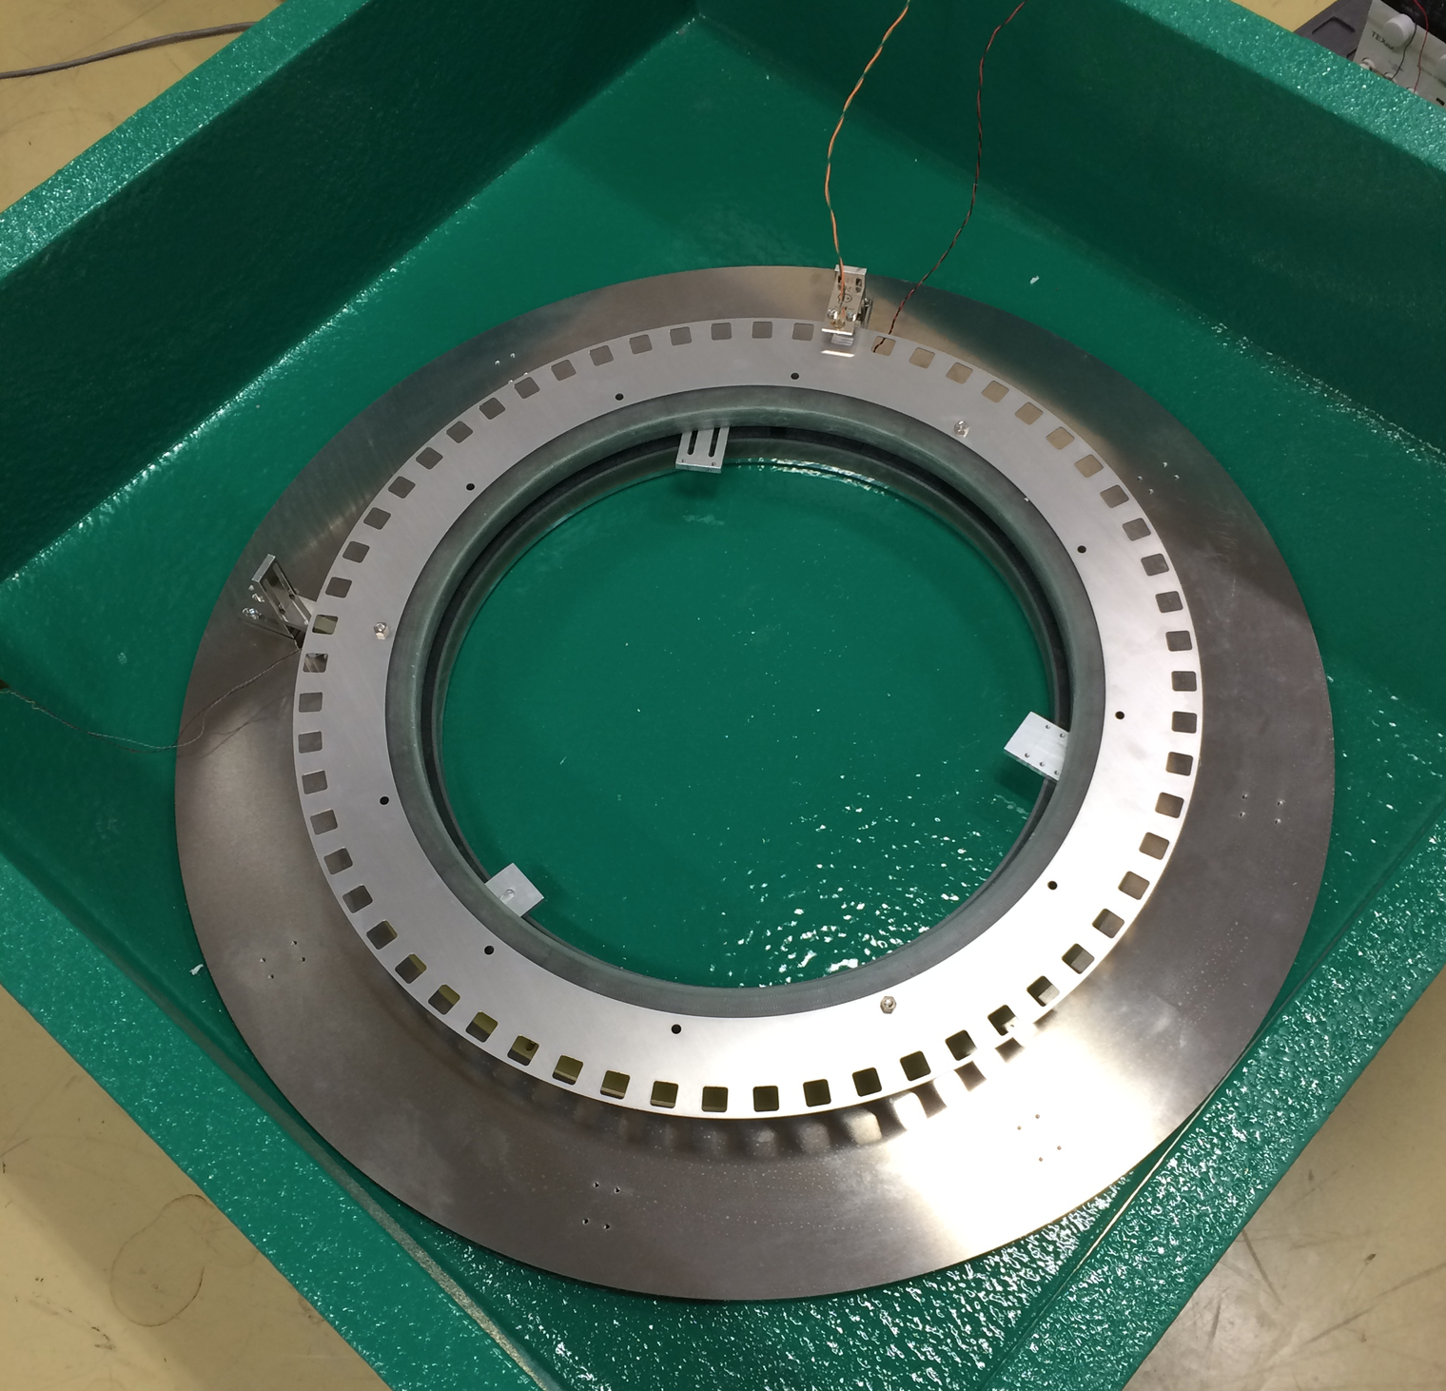
Optical encoder
and chopper
Hall sensor
D=384mm
The spin down is measured by using the optical encoder and the Hall sensor is also mounted between the rotor magnet and the YBCO stator. The entire unit is placed in the Styrofoam box with LN2.

Slide 7
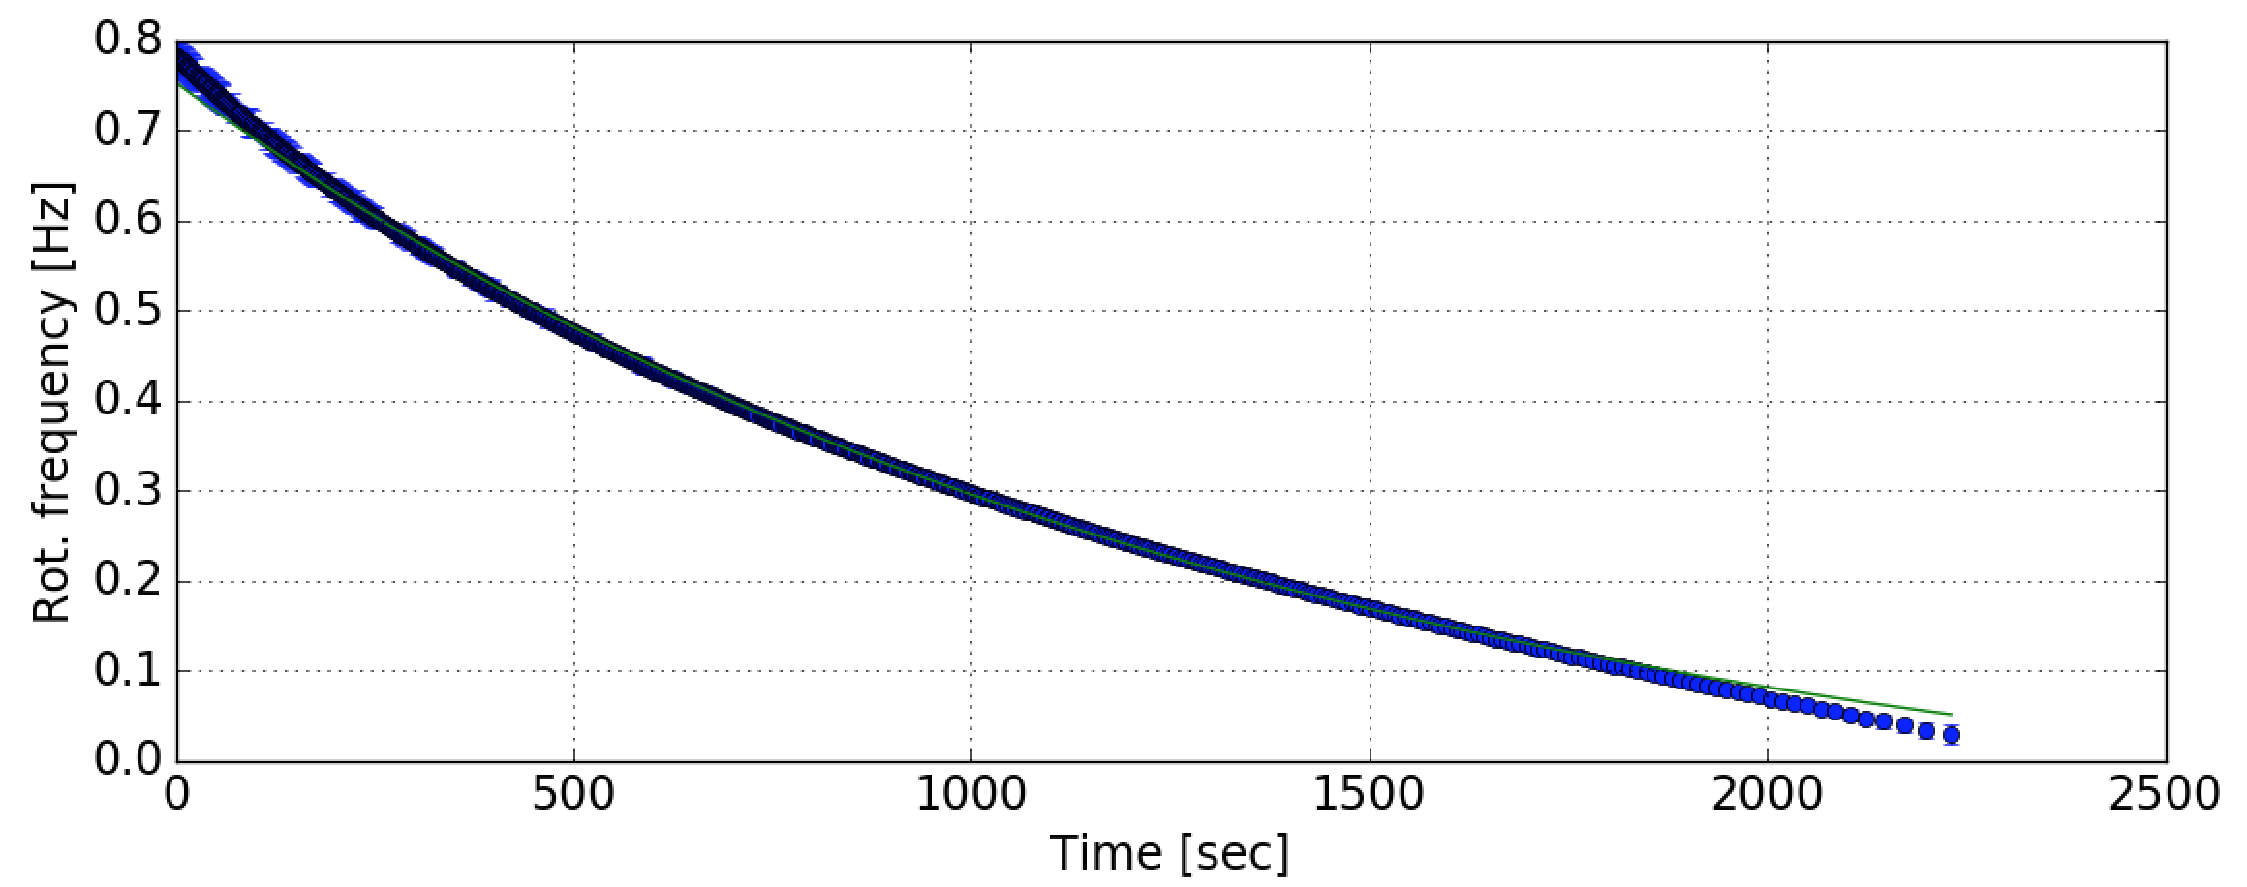
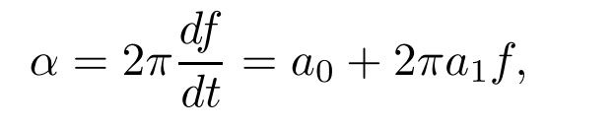
0.8
0.7
0.6
0.5
0.4
Frequency [Hz]
0.3
0.2
0.1
0.0
0
500
1000
1500
2000
2500
Time [sec]
The both data and fit are shown.
Model the spin down as
Spin down measurements at the room temperature with LN2
Eddy current
Air friction
Hysteresis loss

Slide 8
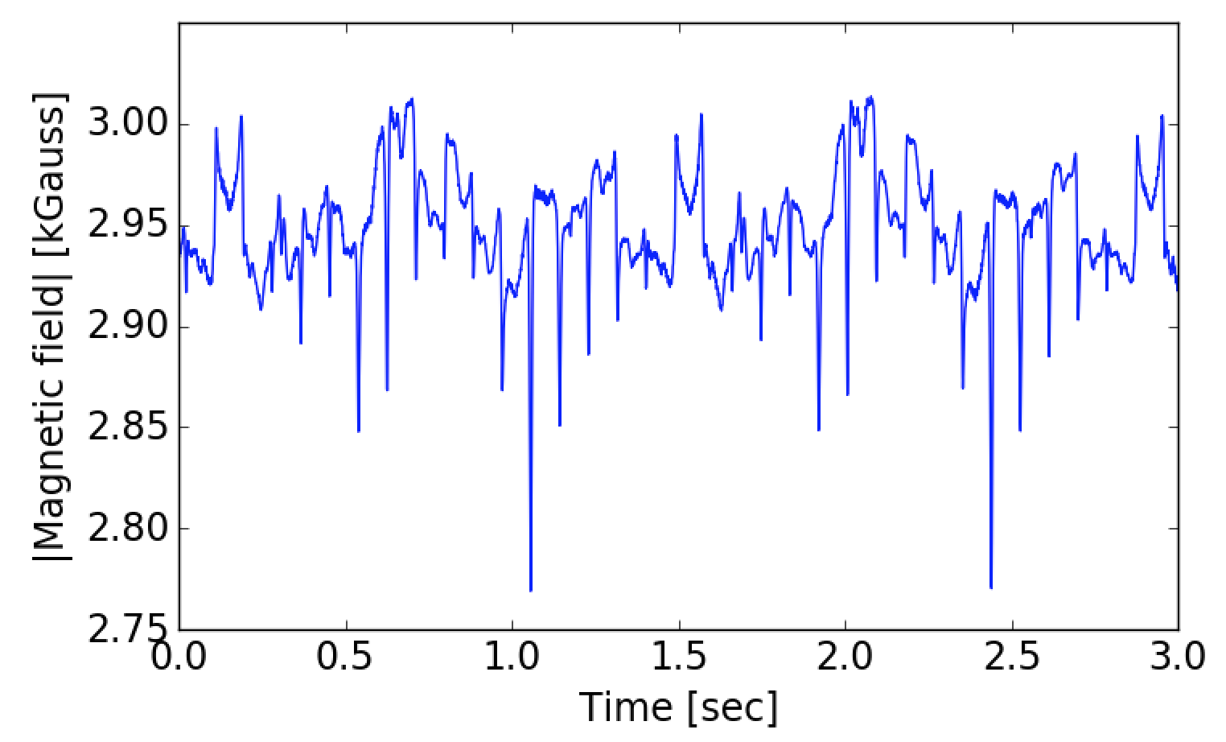
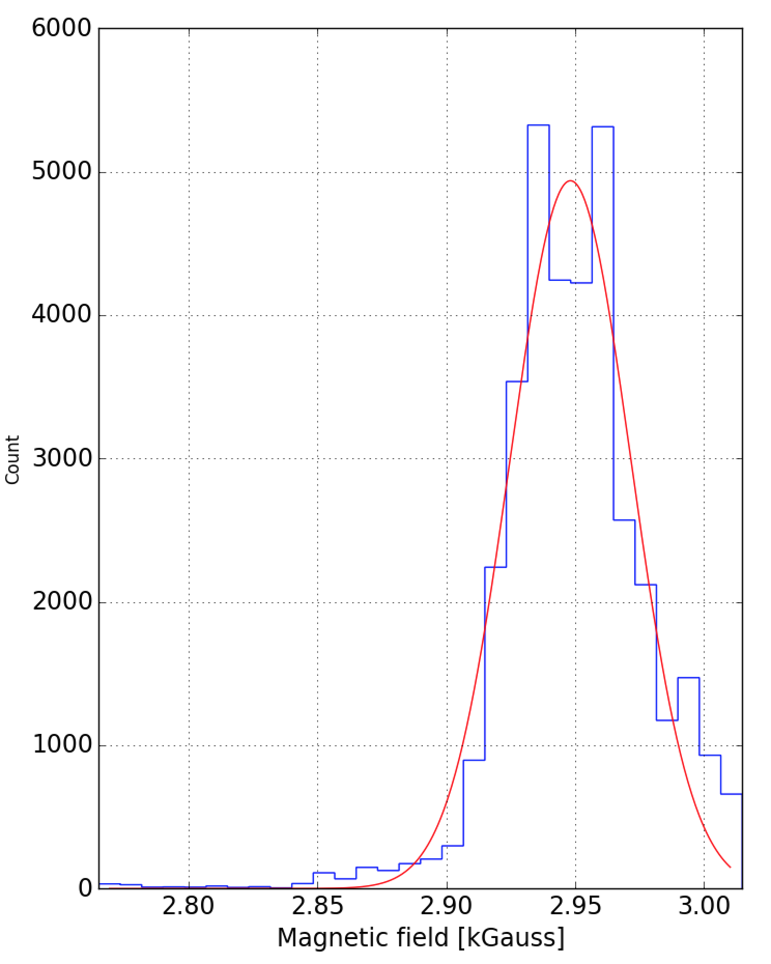
6000
3.00
5000
2.95
4000
Magnetic Field [kG]
Arbitary Unit
2.90
3000
2.85
2000
One period of rotation
2.80
1000
2.75
0
0
0.5
1.0
1.5
2.0
2.5
3.0
0
2.80
2.85
2.90
2.95
3.00
Time [sec]
Magnetic Field [kG]

Slide 9
3.00
2.95
Magnetic Field [kG]
2.90
ΔB
2.85
2.80
One period of rotation
2.75
0
0.5
1.0
1.5
2.0
2.5
3.0
Time [sec]

Slide 10
One period of
rotation

Slide 11
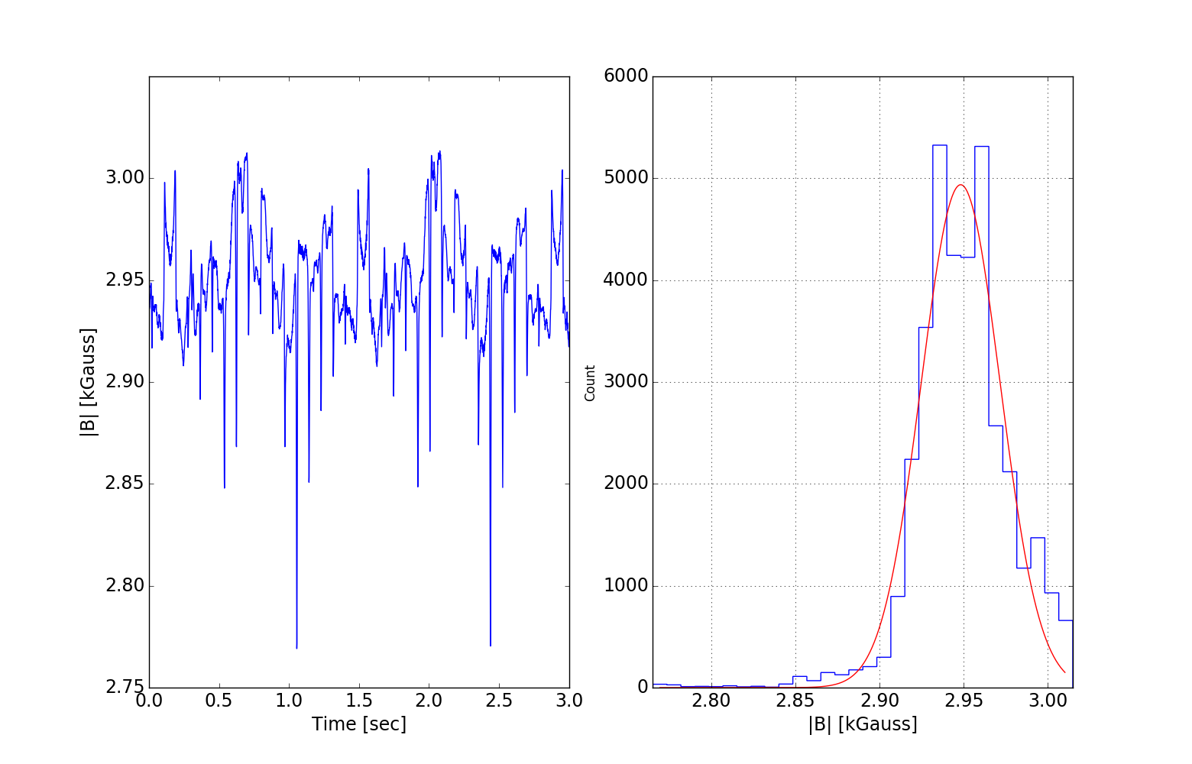
One period of
rotation

Slide 12
Spindown による発熱量計算
P = τω = Iαω , I : イナーシャ , α : 加速度 , ω : 回転速度
I = ½ × M × (Rin^2 + Rout^2) , Rin = 384mm, Rout = 452mm
α (a0) = 5.1e-4 [s^-2] (h=6mm) , α (a0) = 5.7e-3 [s^-2]
ω = 2π (f = 1Hzを仮定)
[M = 3kg リング型 (磁石のみ)の場合]
h = 6mm ) P = (math.pow(384e-3,2) + math.pow(452e-3,2)) * 1/2 * 3 * 2 * math.pi * 5.1e-4 = 1.69mW
h = 3mm ) P = (math.pow(384e-3,2) + math.pow(452e-3,2)) * 1/2 * 3 * 2 * math.pi * 5.7e-3 = 18.9mW
[M = 28kg ディスク型の場合]
ローター重量 21.5kg×1.3(マージン)
(内訳)サファイア： 17kg、 軸受け磁石： 3.4kg、 駆動モーター部： 1.1kg
h = 6mm ) P = math.pow(452e-3,2) * 1/2 * (3 + 21.5*1.3) * 2 * math.pi * 5.1e-4 = 10.1 mW
h = 3mm ) P = math.pow(452e-3,2) * 1/2 * (3 + 21.5*1.3) * 2 * math.pi * 5.7e-3 = 113.2 mW

